Slide 1
Inheritance-I
Said Nabi

Slide 2
What Is Inheritance?
One of the most powerful features of OOP
Provides a way to create a new class from an existing class
The new class inherits all the capabilities of the existing class and can also add capabilities of its own.
The base class is unchanged by this process.
The new class is a specialized version of the existing class

Slide 3
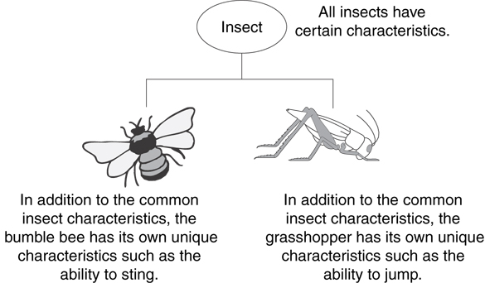
Example: Insects
Insect is generic
Bee and grasshopper are specific

Slide 4
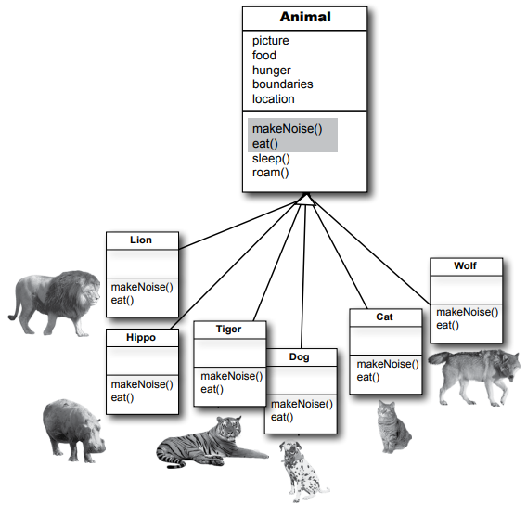
The “IS - A" Relationship
Inheritance establishes an “IS - A" relationship between classes.
  A poodle is a dog
  A car is a vehicle
  A flower is a plant
  A football player is an athlete

Slide 5
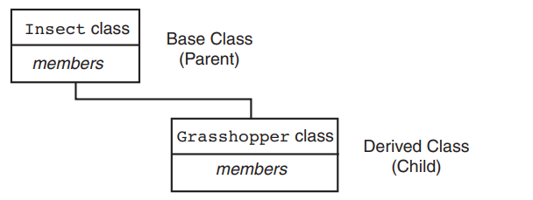
Introduction - Inheritance
Existing classes are called base classes
New classes are called derived classes

Slide 6
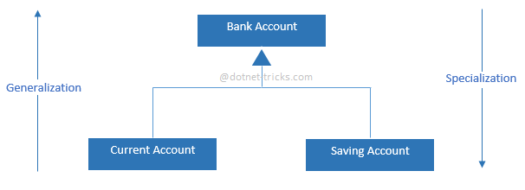
Introduction - Inheritance
Objects of derived classes are more specialized as compared to objects of their base classes

Slide 7
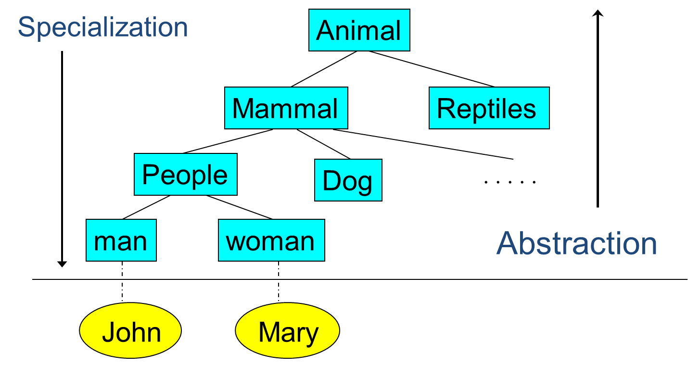
Animals: Class’s hierarchy

Slide 8
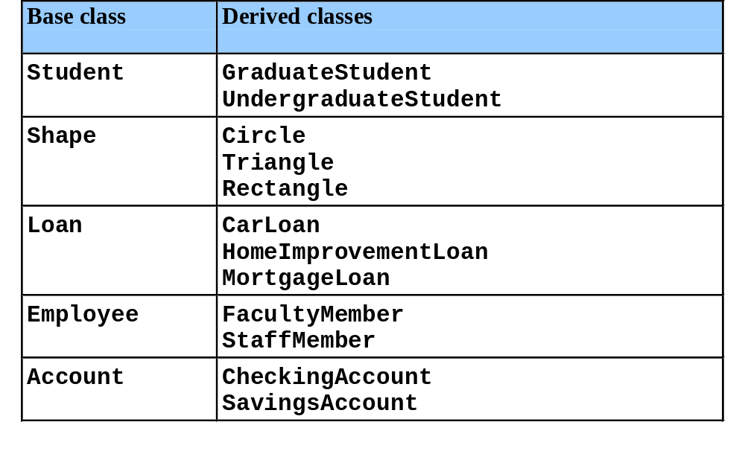
Inheritance Examples

Slide 9
Another example: Shapes class hierarchy
Shape
TwoDimensionalShape
ThreeDimensionalShape
Circle
Square
Triangle
Sphere
Cube
Tetrahedron

Slide 10
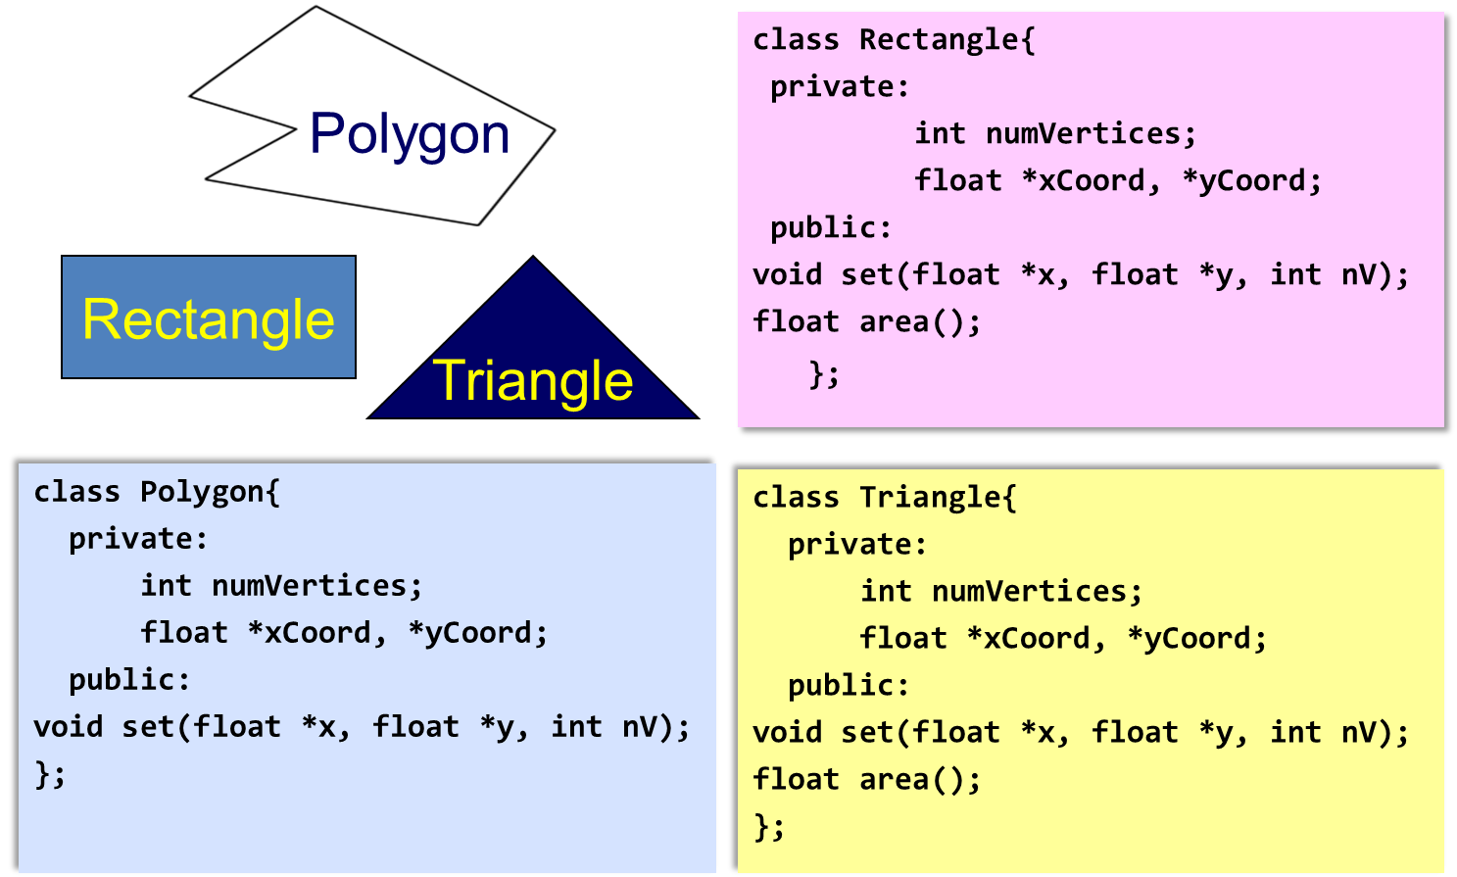
Why Inheritance?

Slide 11
Why Inheritance?
Inheritance provides us a mechanism of software reusability which is one of the most important principles of software engineering
Show similarities
Easy modification by performing modification in one place
Avoid redundancy, leading to smaller and more efficient model, easier to understand

Slide 12
Inheritance – Terminology and Notation
Base class (or parent or superclass) – inherited from
Derived class (or child or subclass) – inherits from the base class
Notation:
  class Student // base class
  {
  };
  class UnderGrad : public Student
  { // derived class
  };

Slide 13
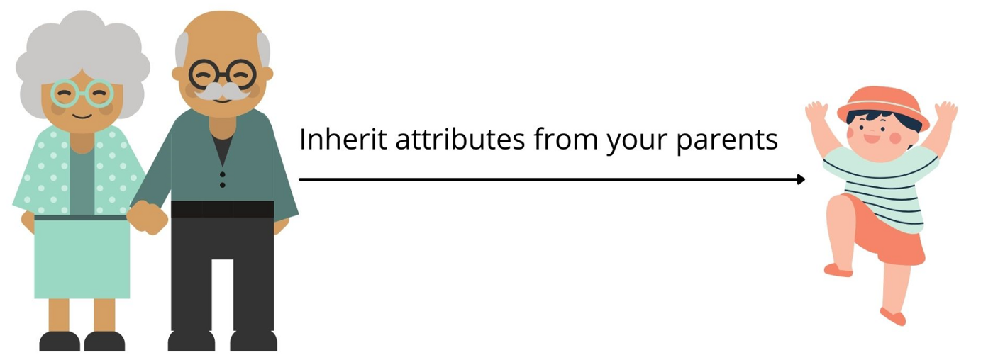
Inheriting Data and Functions
All data members and member functions of base class are inherited to derived class, except
Constructors, destructors and = operator are not inherited

Slide 14
What Does a Child Class Have?
In the Student and underGrad example shown earlier:
An object of the derived class has:
all members defined in child class
all members of the parent class except constructors, destructors and operator=
An object of the derived class can use:
all public members defined in child class
all public members defined in parent class

Slide 15
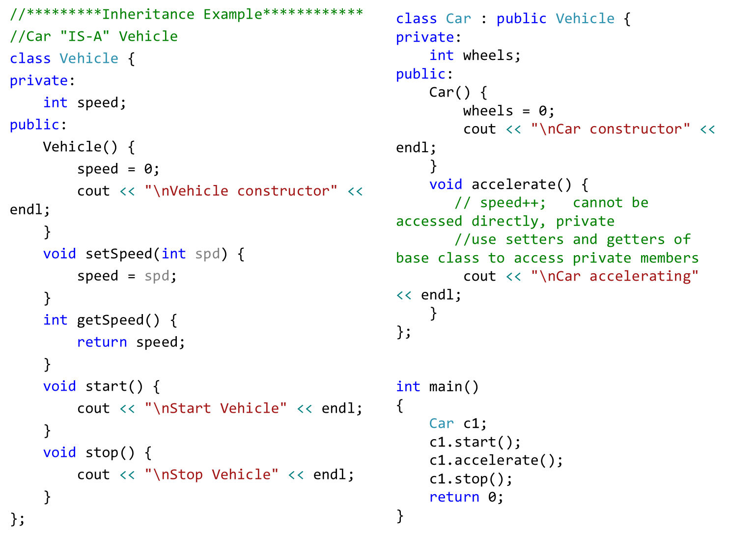

Slide 16
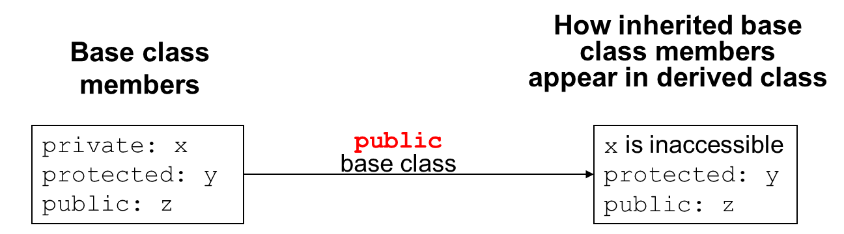
Protected Members and Class Access
protected member access specification: like private, but accessible by objects of derived class

Slide 17
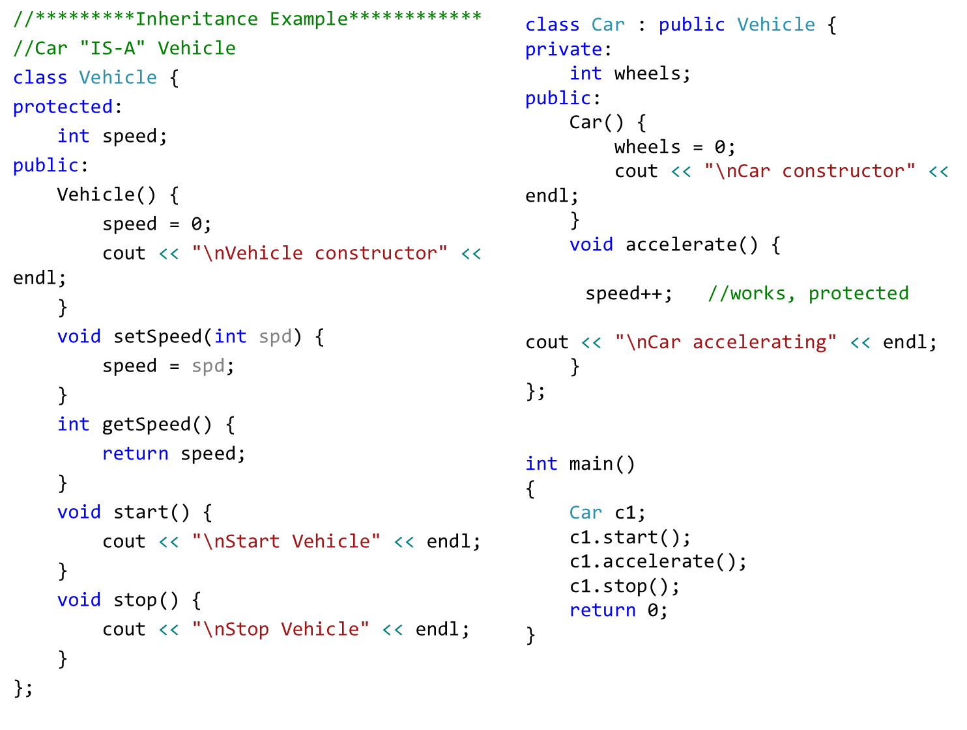

Slide 18
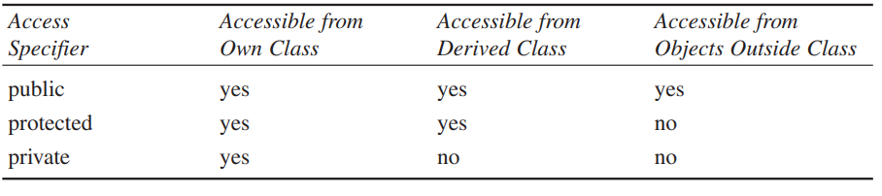
Protected Members and Class Access
protected member access specification: like private, but accessible by objects of derived class

Slide 19
Protected Members and Class Access
protected member access specification: like private, but accessible by objects of derived class
Class access specification: determines how private, protected, and public members of base class are inherited by the derived class

Slide 20
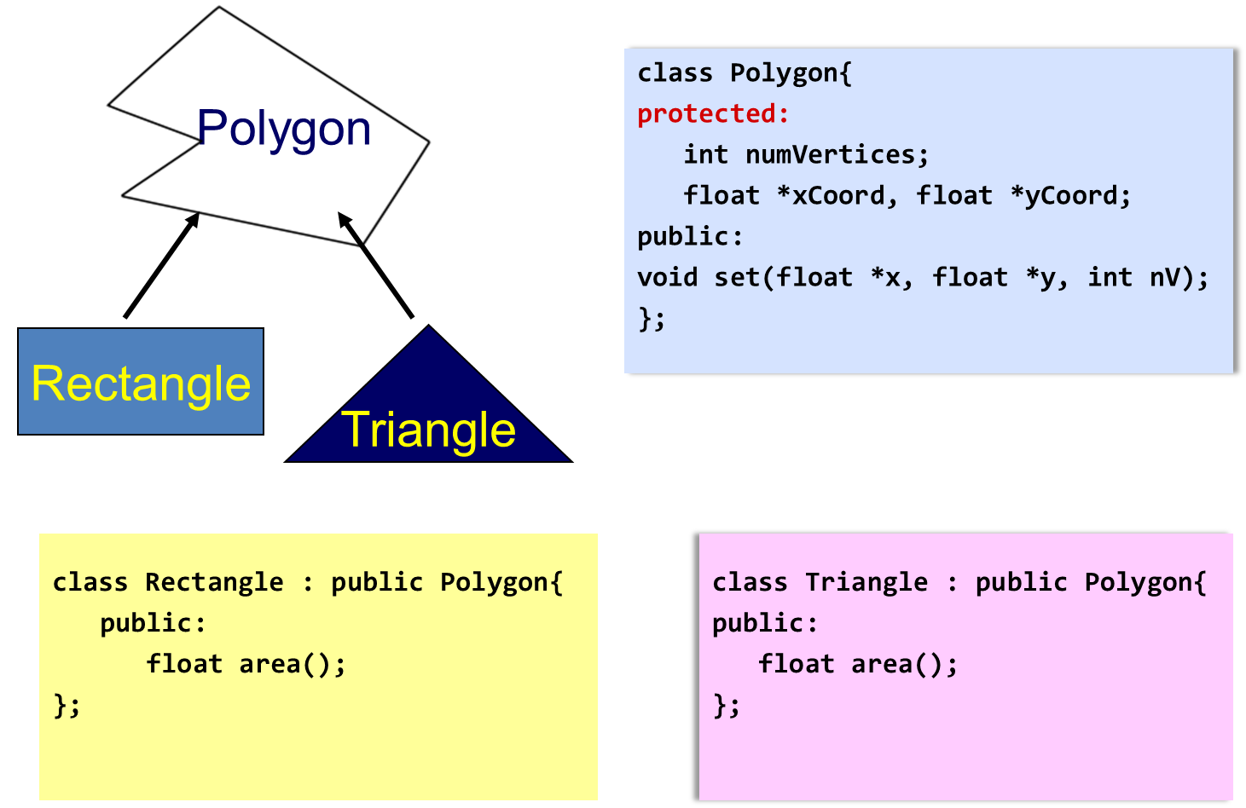
Inheritance Example 1

Slide 21
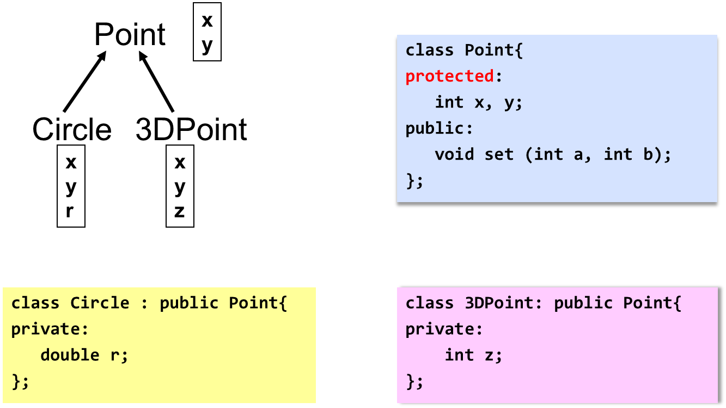
Inheritance Example 2

Slide 22
Dangers of Protected
You should know that there’s a disadvantage to making class members protected.
Say you’ve written a class library, which you’re distributing to the public. Any programmer can access protected members of your classes simply by deriving other classes from them.
This makes protected members considerably less secure than private members.
To avoid corrupted data, it’s often safer to force derived classes to access private data in the base class using only public setters and getters.

Slide 23
Constructors and Destructors in Base and Derived Classes
Constructors and destructors of Base class are NOT inherited
Derived classes can have their own constructors and destructors
When an object of a derived class is created, the base class’s constructor is executed first, followed by the derived class’s constructor
When an object of a derived class is destroyed, its destructor is called first, then that of the base class

Slide 24
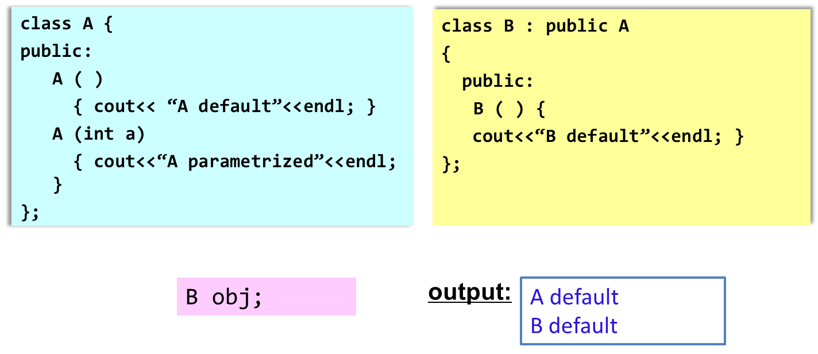
Constructor Rules for Derived Classes
The default constructor and the destructor of the base class are always called when a new object of a derived class is created or destroyed.

Slide 25

Constructor Rules for Derived Classes
The default constructor and the destructor of the base class are always called when a new object of a derived class is created or destroyed.

Slide 26
Passing Arguments to Base Class Constructor
Allows selection between multiple base class constructors
Specify arguments to base constructor on derived constructor heading
Inline constructor syntax:
  Square(int side) : Rectangle(side, side)
Can also be done with out-of-line constructors
Square::Square(int side):Rectangle(side, side)
Must be done if base class has no default constructor
Object Oriented Programming-Spring 23

Slide 27
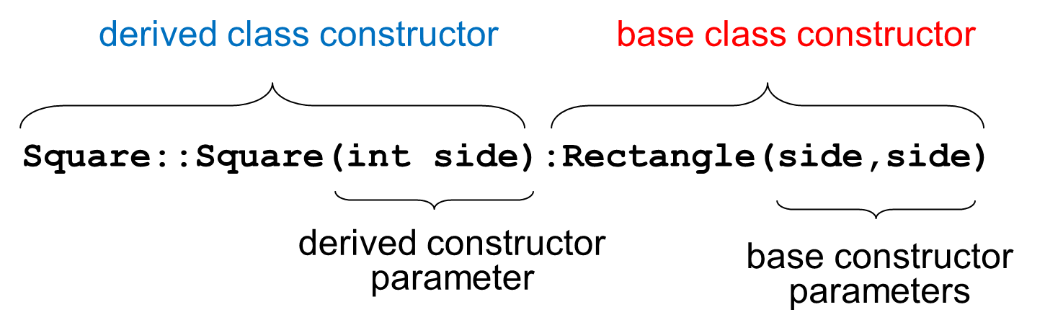
Passing Arguments to Base Class Constructor
Object Oriented Programming-Spring 23

Slide 28
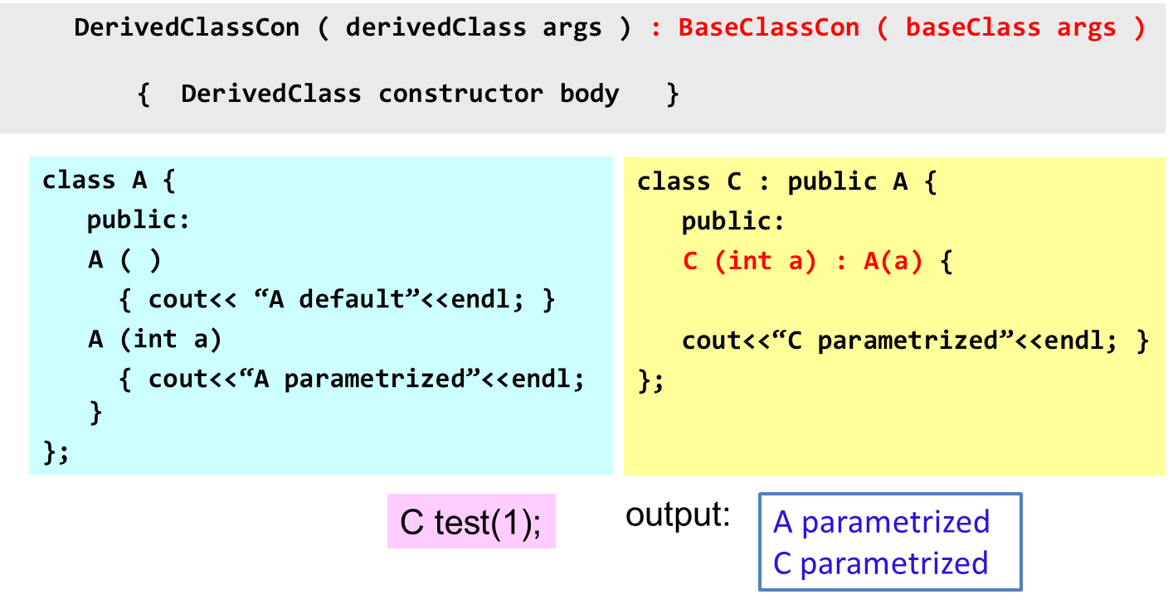
Constructor Rules for Derived Classes
You can specifically call a constructor of the base class other than the default constructor
Object Oriented Programming-Spring 23

Slide 29
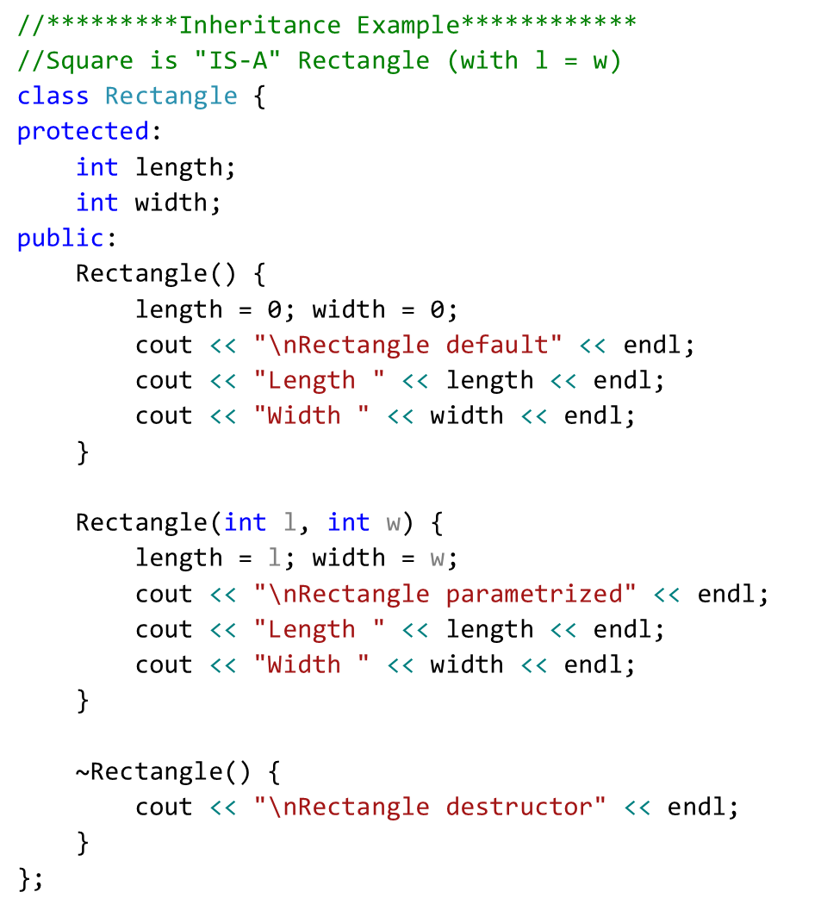
Object Oriented Programming-Spring 23

Slide 30
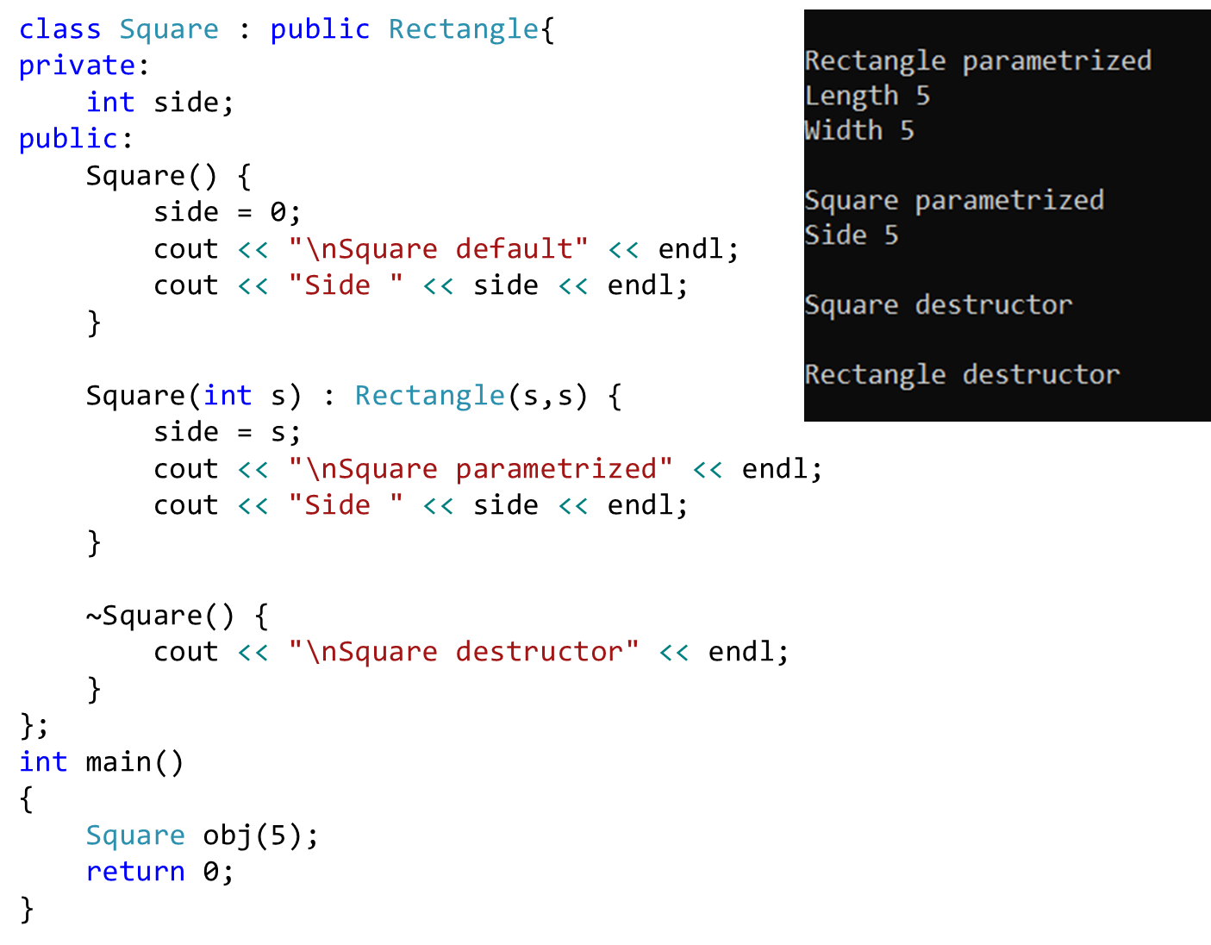
Object Oriented Programming-Spring 23

Slide 31
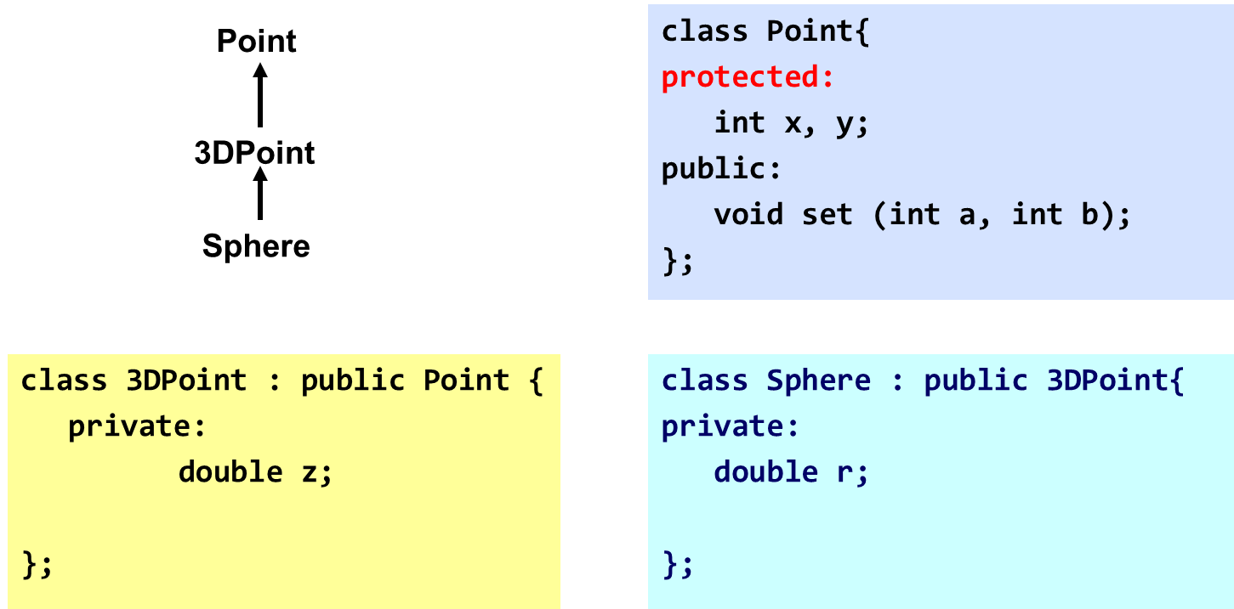
Class Derivation
Point is the base class of 3D-Point, while 3DPoint is the base class of Sphere

Slide 32
Order of execution of Constructors/Destructors
Chain of constructor calls:
  Point → Circle → Cylinder
  Point constructor executes first
  Then circle and last Cylinder

Slide 33
Order of execution of Constructors/Destructors
Chain of destructor calls
  Reverse order of constructor chain
      Cylinder → Circle → Point
  Destructor of derived-class called first
  Destructor of next base class up hierarchy next
  Continue up hierarchy until final base reached
  After final base-class destructor, object removed from memory

Slide 34
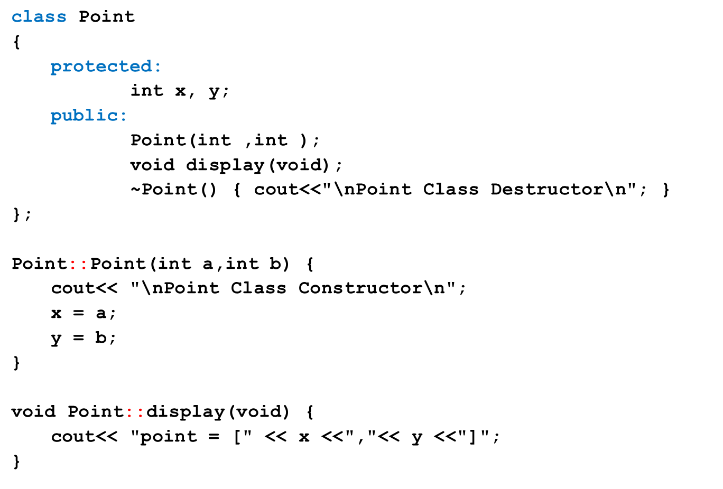
Example

Slide 35
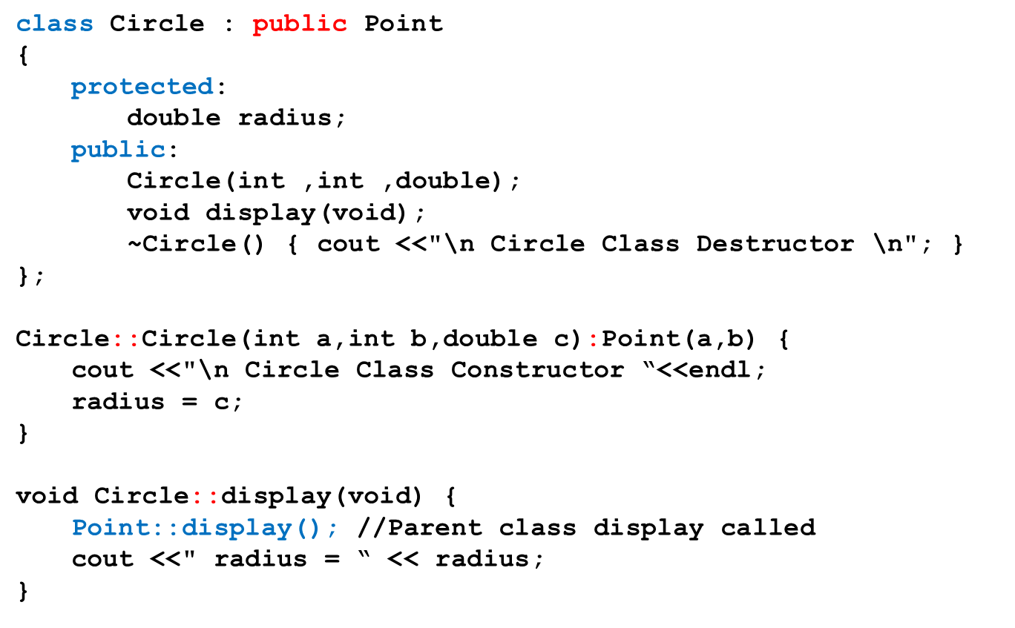
Example – cont.

Slide 36
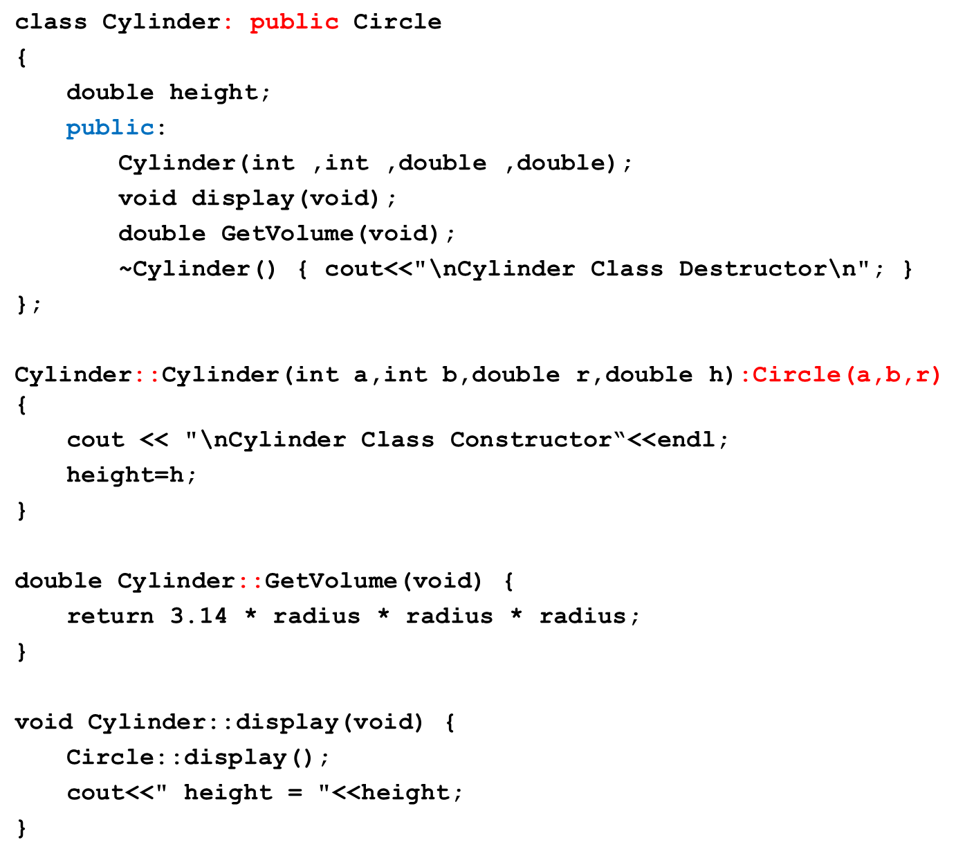

Slide 37
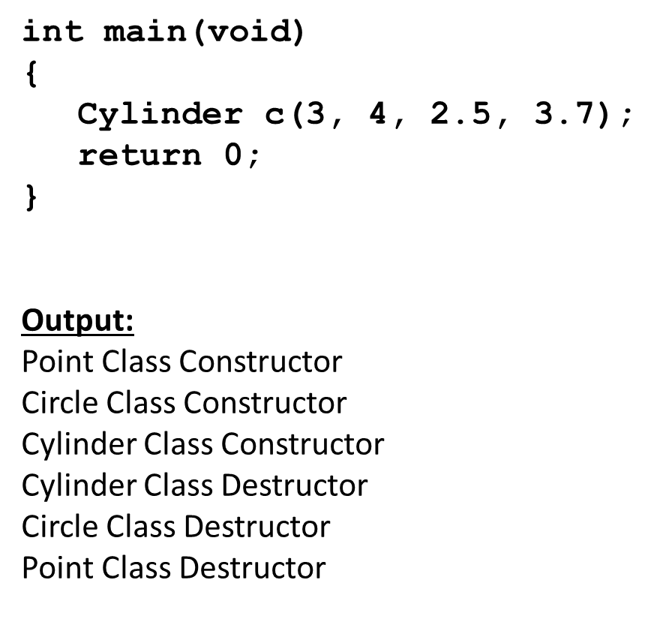
Example – cont.

Slide 38
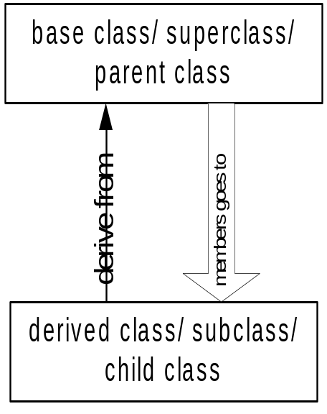
Data vs Class Access Specifier
Two levels of access control over class members
  class definition
  inheritance type
class Point{
protected: int x, y;
public: void set(int a, int b);
};
class Circle : public Point{
… …
};

Slide 39
Types of inheritance/ Class access specifier
Public
Private
protected

Slide 40
Public Inheritance
With public inheritance,
  public and protected members of the base class become respectively public and protected members of the derived class
class derived : public base{
… …
};

Slide 41
Protected Inheritance
Public and protected members of the base class become protected members of the derived class.
class derived : protected base{
… …
};

Slide 42
Private Inheritance
With private inheritance, public and protected members of the base class become private members of the derived class.
class derived : private base{
… …
};

Slide 43
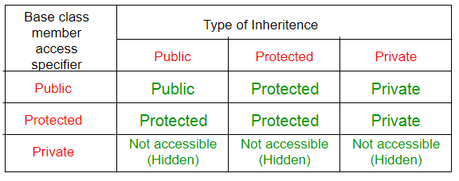
public, protected and private Inheritance

Slide 44
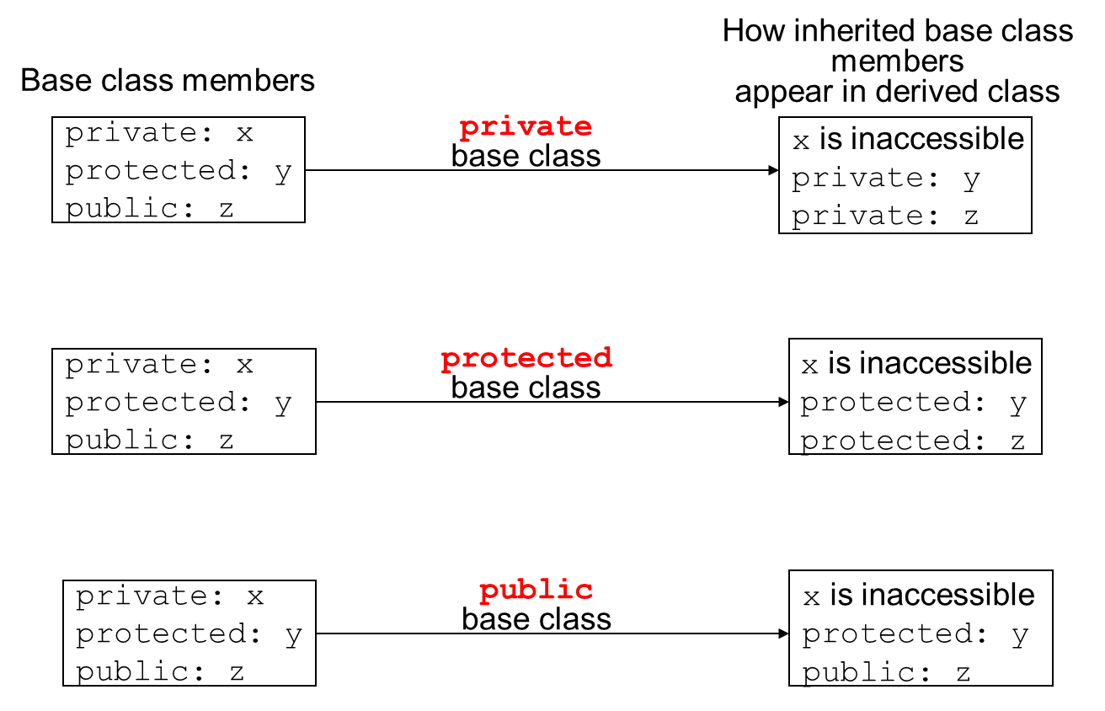
Inheritance vs. Access

Slide 45
Class Access Specifiers – When to use?
public – object of derived class can be treated as object of base class (not vice-versa)
protected – more restrictive than public, but allows derived classes to know details of parents
private – prevents objects of derived class from being treated as objects of base class.

Slide 46
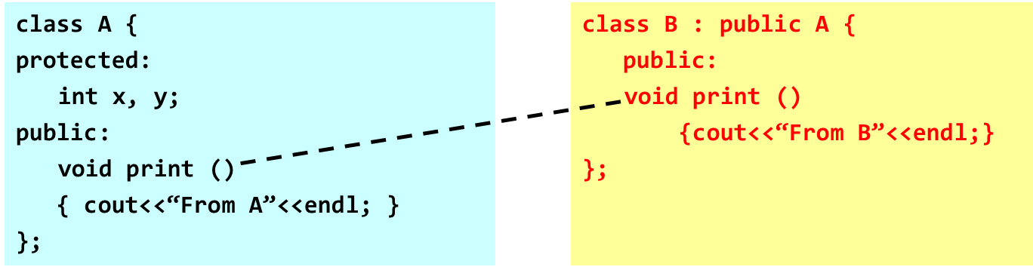
Method Overriding
A derived class can override methods defined in its parent class.
  the method in the subclass must have the identical signature to the method in the base class.
  a subclass implements its own version of a base class method.

Slide 47
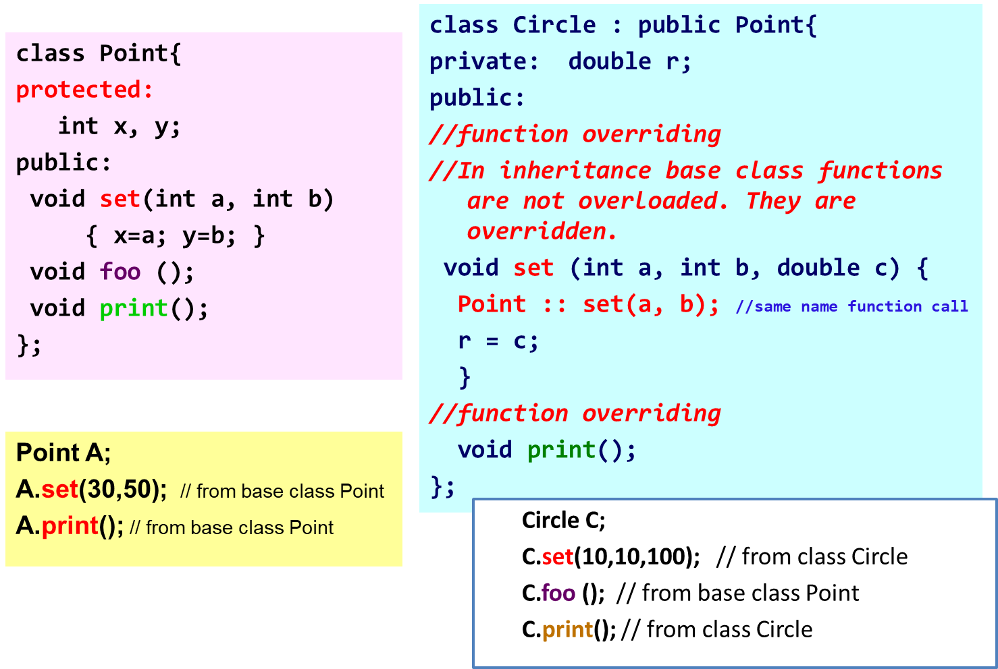
Method Overriding

Slide 48
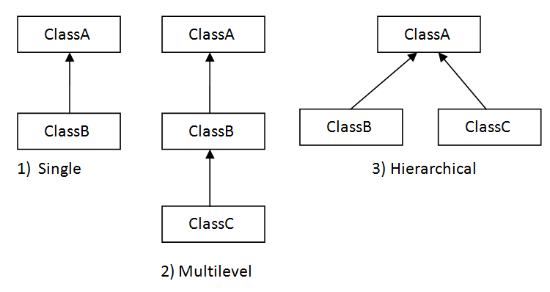
Types of Inheritance
Single inheritance
  Inherits from one base class
Multi-level inheritance
  Chain of inheritance
Multiple inheritance
  Inherits from multiple classes

Slide 49
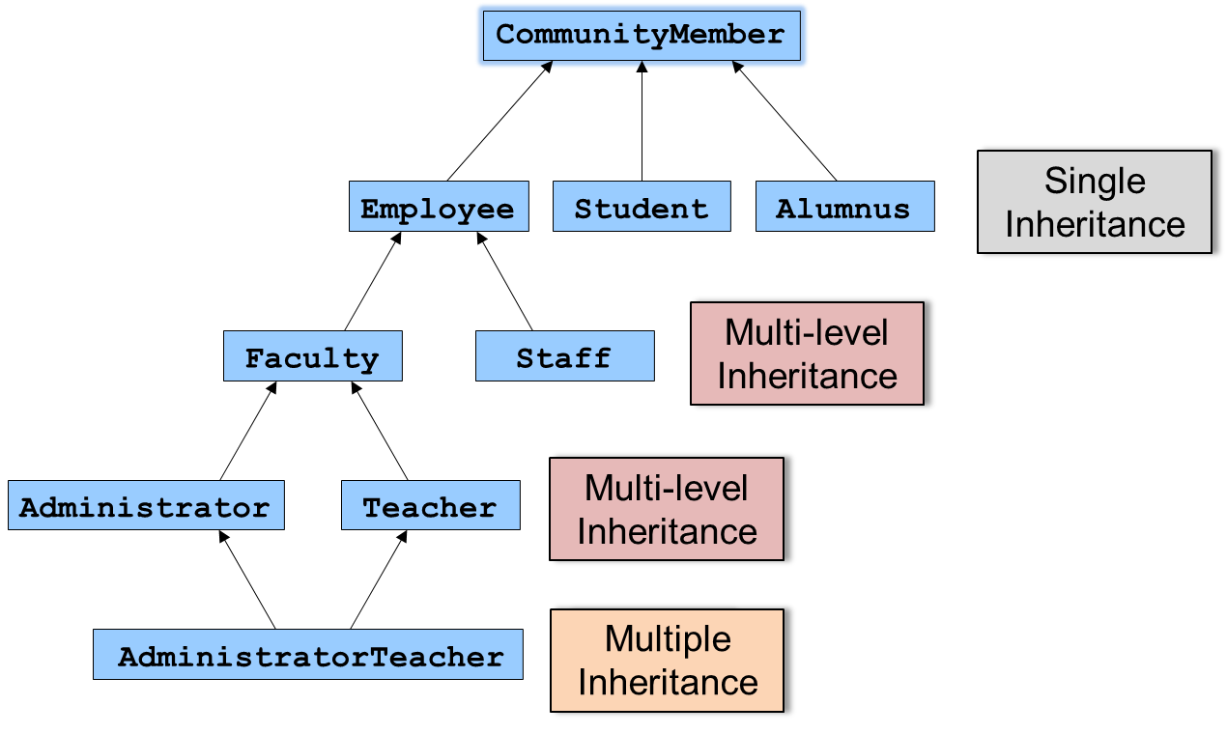
Types of Inheritance: University Example

Slide 50
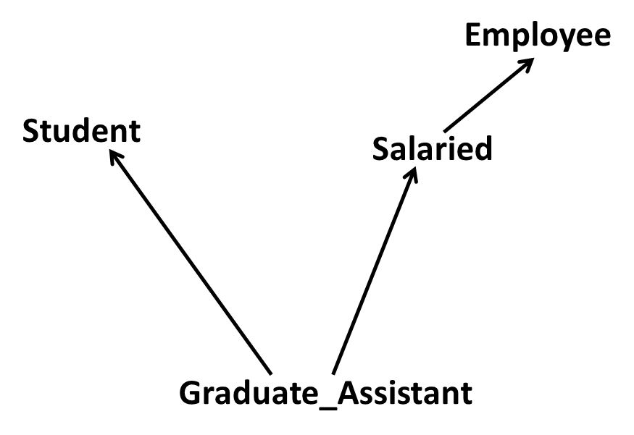
Multiple Inheritance

Slide 51
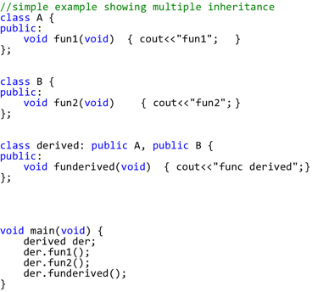
What is Multiple Inheritance?
If class A inherits from more than one class,
  i.e., A → (B1, B2, ..., Bn), we speak of multiple inheritance.

Slide 52
Multiple Inheritance
This may introduce naming conflicts:
  if at least two of its base classes define properties (data members or member functions) with the same name

Slide 53
Ambiguity in Multiple Inheritance
class Student {
int id;
int age;
public:
  int GetAge() const { return age; }
  int GetId() const { return id; }
  void SetAge( int n ) { age = n; }
  void SetId( int n ) { id=n; }
};

Slide 54
Ambiguity in Multiple Inheritance
class Employee {
  public:
  int GetAge() const { return age; }
  int SetAge( int n ) { age = n; }
  void SetId( int n) { id=n; }
  int GetId(void) const { return id; }
  private:
  int age;
  int id;
};

Slide 55
Ambiguity in Multiple Inheritance
class Salaried : public Employee {
float salary;
public:
  float GetSalary() const { return salary; }
  void SetSalary( float s ) { salary=s; }
};
class GradAssistant :public Student, public Salaried {
public:
void Display() const {
cout<<GetId()<<","<<GetSalary()<<","<<GetAge();
//ambiguity
}

Slide 56
Ambiguity in Multiple Inheritance
int main(void) {
GradAssistant ga;
ga.SetAge(20); //ambiguity
ga.SetId(15); //ambiguity
ga.Display(); //ambiguity inside display()
}
//program will not compile and will generate errors

Slide 57
What is the solution?
Call functions explicitly by specifying name of class and using scope resolution operator to remove ambiguity:
  Direct solution:
  Student::SetAge() or Salaried::SetAge()

Slide 58
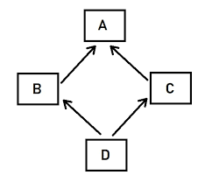
The Diamond Problem
class A {
public:
void Foo() {}
}
class B : public A {}
class C : public A {}
class D : public B, public C {}
D d;
d.Foo();
is this B's Foo() or C's Foo() ?? ambiguous

Slide 59
What is the solution?
Call functions explicitly by specifying name of class and using scope resolution operator to remove ambiguity:
  Direct solution:
  Student::SetAge() or Salaried::SetAge()
  2. Virtual inheritance

Slide 60
Solution (virtual inheritance)
class A {
public: void Foo() {}
}
class B : public virtual A {
}
class C : public virtual A {
}
class D : public B, public C {
}
D d;
d.Foo(); // no longer ambiguous

Slide 61
Virtual Inheritance
Virtual inheritance is a C++ technique that ensures that only one copy of common base class's member variables are inherited by second-level derivatives (a.k.a. grandchild derived classes)

Slide 62
Example
class PoweredDevice{
public:
PoweredDevice(int nPower){
cout << "PoweredDevice: " <<
nPower << endl;
}
};

Slide 63
class Scanner: public PoweredDevice {
public:
Scanner(int nScanner, int nPower) : PoweredDevice(nPower)
{
cout << "Scanner: " << nScanner << endl;
}
};
class Printer: public PoweredDevice {
public:
Printer(int nPrinter, int nPower) : PoweredDevice(nPower)
{
cout << "Printer: " << nPrinter << endl;
}
};

Slide 64
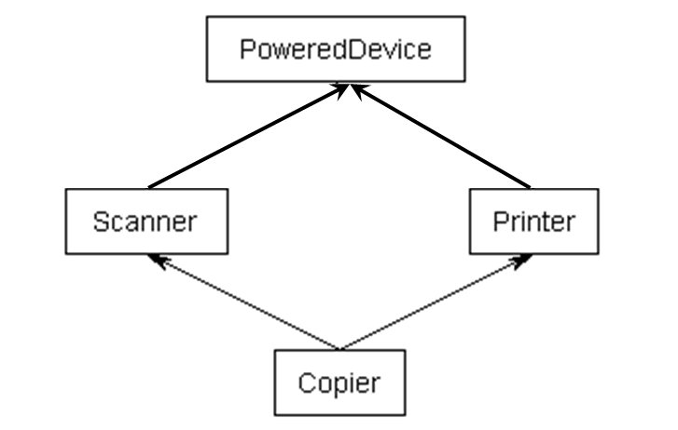
Example
class Copier: public Scanner, public Printer
{
public:
Copier(int nScanner, int nPrinter, int nPower) :
Scanner(nScanner, nPower), Printer(nPrinter, nPower){
}
};

Slide 65
Example
int main(){
Copier cCopier(1, 2, 3);
}
What should be the output?

Slide 66
Example
int main(){
Copier cCopier(1, 2, 3);
}
What should be the output?
PoweredDevice: 3
Scanner: 1
PoweredDevice: 3
Printer: 2

